Slide 1
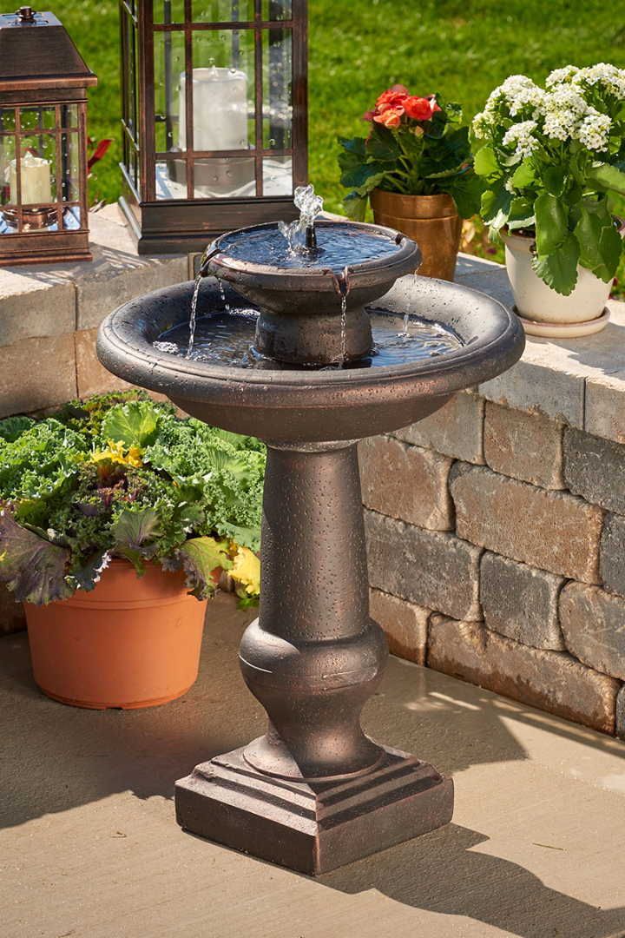
Smart Water Fountains using IOT
Upgrade your water fountains with the internet of things for a smarter, more sustainable future.

Slide 2
What are smart water fountains?
Sustainable 🌱
User-Friendly 🙌
Cost-effective 💰
Designed with eco-friendly materials and sensors that track water usage, smart water fountains help reduce waste and conserve water resources.
Intuitive interfaces make it easy to find and use the water fountain. Plus, real-time data on water quality keeps users informed of potential risks.
Save money on utilities and maintenance costs by automatically tracking usage data and detecting malfunctions before they occur.

Slide 3
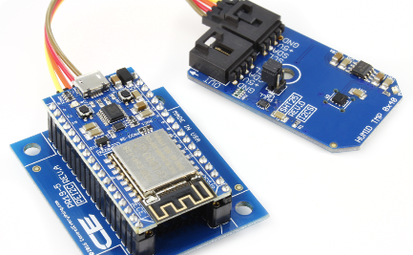
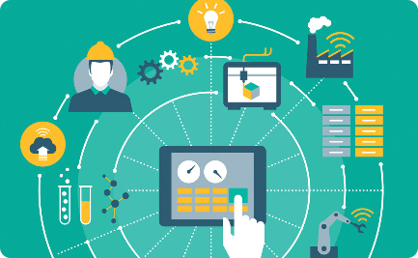
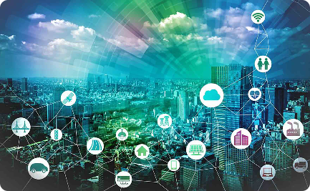
The benefits of integrating IOT
Data Collection 📊
Remote Monitoring 🌍
Smart Control 🤖
Real-time data collection helps monitor water usage and detects potential malfunctions, reducing water waste and operational costs.
Use remote monitoring and predictive maintenance to detect issues before they occur, and keep repair costs down.
Integrate iot connectivity to allow for remote control of fountains, enabling easy management and monitoring.

Slide 4
Features of smart water fountains
1
Smart Sensors
Track usage data and detect potential malfunctions in real-time for better efficiency and cost savings.
Touchless Controls
2
Improve sanitation and reduce the spread of germs with touchless controls and automatic dispensing.
3
Water Quality Monitoring
Track water quality and detect potential hazards before they become an issue with smart sensors and real-time data collection.

Slide 5

How IOT is integrated
1
Smart Sensors and Controls
2
Data Analysis
3
Cloud Connectivity
Data analysis tools can provide real-time insights into usage patterns and maintenance requirements, saving time and reducing costs.
Connecting fountains to the cloud allows for easy management and monitoring of multiple locations from a single platform.
Integrating sensors and controls into traditional hardware enables real-time data collection and remote management via the internet of things.

Slide 6

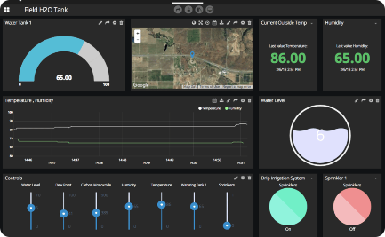
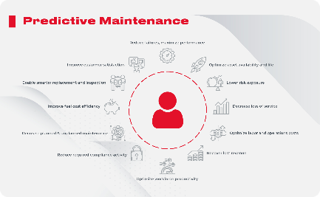
Data collection and analysis
Usage Analytics
Dashboard Reporting
Predictive Maintenance
Track usage patterns and analyze data on water consumption, temperature, and sanitation to improve operating efficiencies and reduce costs.
View data in real-time via a customizable dashboard interface, providing insights into performance metrics and usage patterns.
Use data analysis tools to identify potential issues before they become major problems, and provide predictive maintenance to keep fountains running smoothly.

Slide 7
Impact on environment and cost
1
Environmental Impact ♻️
Reduce water waste and environmental impact with water conservation and eco-friendly materials, while also increasing the lifespan of fountain hardware and reducing waste.
Cost Savings 💰
2
Save money on utilities and maintenance costs by using real-time data collection and predictive maintenance to detect malfunctions before they become costly problems.
3
Improved User Experience 👍
Boost user satisfaction with touchless controls, water quality monitoring, and improved operational efficiency, leading to increased productivity and overall satisfaction.

Slide 8
Conclusion and future possibilities
Improved Sustainability 🌱
Increased Cost Savings 💸
Future Innovations 🚀
The possibilities for smart water fountains remain endless, including real-time usage analytics and cloud-connected monitoring.
By using smart water fountains and iot technology, we can continue to improve sustainability and reduce environmental impact across various industries, from parks to schools to corporate campuses.
Real-time data collection and predictive maintenance provide the opportunity to reduce operational costs and improve bottom-line growth.

